Slide 1
CUBES, CUBOIDS & DICES
SHABANA

Slide 2
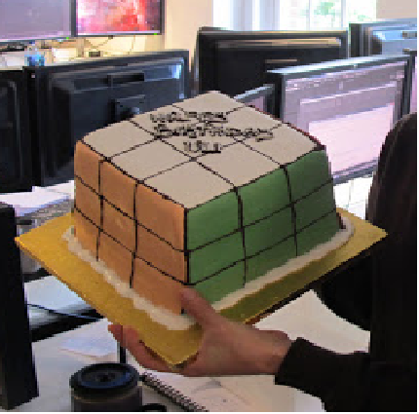
BIRTHDAY PARTY
1000 GUESTS
OPPOSITE FACES –
BUTTERSCOTCH,
CHOCOLATE AND
STRAWBERRY
FLAVOURED CREAM
Only Chocolate creamed
cake pieces
Cake pieces with both strawberry
and butterscotch cream
Cake pieces with no cream at all

Slide 3
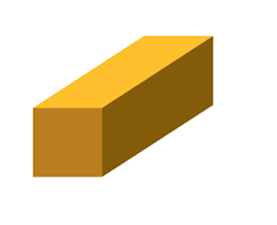
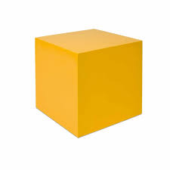
KICK START
Corners – 8
Edges – 12
Faces – 6

Slide 5
CUTTING INTO THE CUBE
For every (n-1) cuts made along the side of a cube, we obtain n pieces.
Total number of pieces obtained with X cuts in x axis, Y cuts in y axis and Z cuts in z axis =
(X+1)*(Y+1)*(Z+1)
Note that, all the pieces will not necessarily be cubes. They can be cubes or cuboids. All the pieces are
cubes when X = Y = Z and all the cuts are equidistant.
MINIMUM NUMBER OF PIECES WITH A GIVEN TOTAL NUMBER OF CUTS – when the cuts are made
along the same axis
MAXIMUM NUMBER OF PIECES WITH A GIVEN TOTAL NUMBER OF CUTS – Divide the number of cuts
equally among the three axis, if not divisible, minimize the difference between the number
of cuts in any two axis
.

Slide 6
CUTTING INTO THE CUBE
NUMBER OF CUTS FROM TOTAL NUMBER OF PIECES GIVEN
The question can also mention the total number of pieces formed after a certain number of cuts. We need to find the number of cuts in different axis based upon the requirement of the question.
Suppose, a cube is cut into 10 pieces. Now 10 = (X+1)*(Y+1)*(Z+1). Now 10 is to be represented as
the product of 3 numbers or factors. We can have, 10 = 1*1*10 or 1*2*5.
Minimum numbers of cuts is obtained if we factorize the number of pieces into three equal factors.
If three equal factors are not possible, then we should minimize the difference between the numbers. In case of 10 pieces, 1*2*5 gives minimum difference between factors.
To maximize the total number of cuts, all the cuts are made in one axis. For instance, for 10 pieces,
factors are 10*1*1 that means the x-axis cuts are 9 and no cut is made in other two axis.

Slide 7
PAINTING A CUBE
FOR SINGLE COLOURED CUBES,
The number of 3 faces painted SIC = 8
The number of 2 faces painted SIC = 12(n-2)
The number of 1 faces painted SIC = 6(n-2)²
The number of 1 faces painted SIC = (n-2)³
For Bi, Tri or multi coloured cubes, 2 faces and 1 face painted differs according to the question.

Slide 8
THINK IN A JIFFY
There are 5 cuts made along the side of a cube. How many pieces of the cube are
formed?
What is the minimum number of pieces we get from 13 cuts
If 7 cuts are made along all the three dimensions of the cube, then how many small
cubes will be obtained.
What is the maximum number of pieces obtained with 15 cuts
What is the maximum number of pieces obtained with 20 cuts
What is the difference between maximum number of pieces and the minimum number of pieces obtained with 31 cuts
What is the minimum number of cuts required in a cube to cut into 40 pieces
What is the difference between maximum and minimum number of cuts required in a
cube to cut into 40 pieces
A cube of side 3 cm is cut into smaller cubes of side 0.25cm. How many cuts
were made into the cube?

Slide 9
DIRECTIONS:
A Cube is taken with each pair of adjacent sides painted red, blue & green. This is cut into 216 smaller identical cubes.
E
How many small cubes exist with only the colour blue on their faces?
How many small cubes without any side painted red exist?
How many small cubes exist with at least two different colours on their face?
A
S
Y

Slide 10
Directions: One hundred and twenty-five cubes of the same size are arranged in the form of a cube on a table. Then a column of five cubes is removed from each of the four corners. All the exposed faces of the rest of the solid (except the face touching the table) are coloured red. Now, answer these questions based on the above statement:
(1) How many small cubes are there in the solid after the removal of the columns?
(2) How many cubes do not have any coloured face?
(3) How many cubes have only one red face each?
(4) How many cubes have two coloured faces each?
(5) How many cubes have at least 3 coloured faces each?

Slide 11
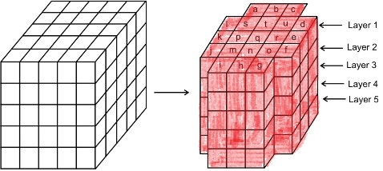
(1) How many small cubes are there in the solid after the removal of the columns?

Slide 12
(2) How many cubes do not have any coloured face?

Slide 13
(3) How many cubes have only one red face each?

Slide 14
(4) How many cubes have two coloured faces each?

Slide 15
(5) How many cubes have at least 3 coloured faces each?

Slide 16
DIRECTIONS:
A cuboid whose dimensions are 4 x 3 x 3 cm³ are painted with different colours. The
opposite faces of the dimensions 4 3 are coloured black. The opposite faces of the
dimensions 4 3 are coloured white. The opposite faces of the dimensions 3 3 are
coloured blue. Now the cuboid is cut into smaller cubes of side 1cm.
How many small cubes will have only 2 faces coloured?
How many small cubes will have no faces coloured?
How many small cubes will have only 3 faces coloured?
How many small cubes will have only one face coloured?

Slide 17
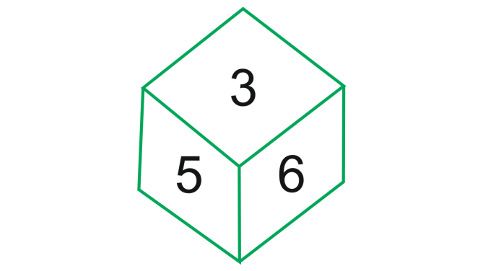
DICES
STANDARD DICE
- GENERAL DICE
PRACTICE PROBLEMS
Number opposite to 3 ?

Slide 18
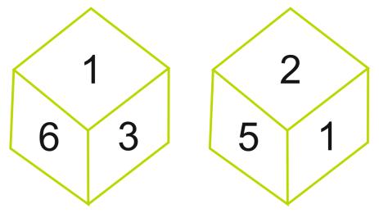
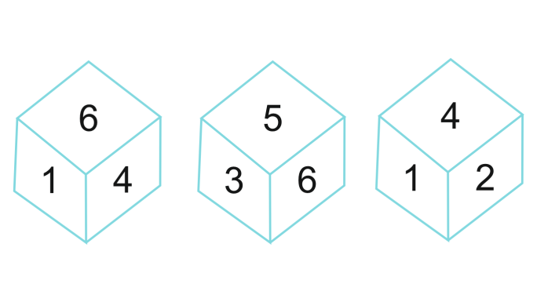
MORE PRACTICE PROBLEMS
Opposite to 6
If 2 is in bottom, which number is on top?

Slide 19
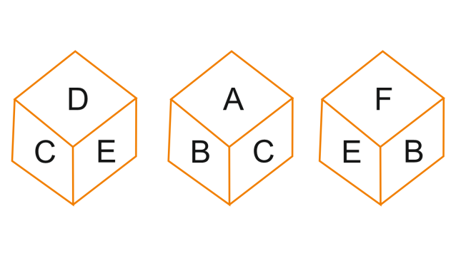
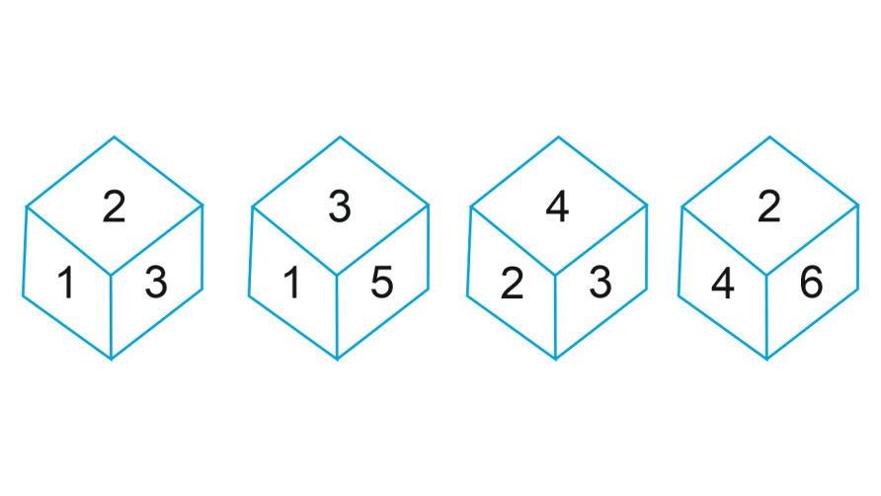
MORE PRACTICE PROBLEMS
In front of C ?
Opposite to 3 ?

Slide 20
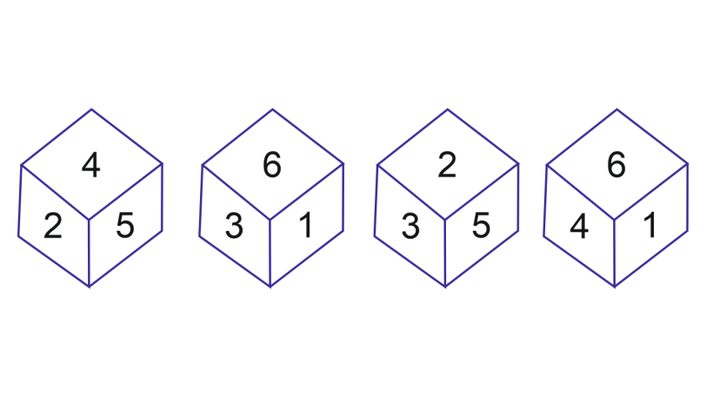
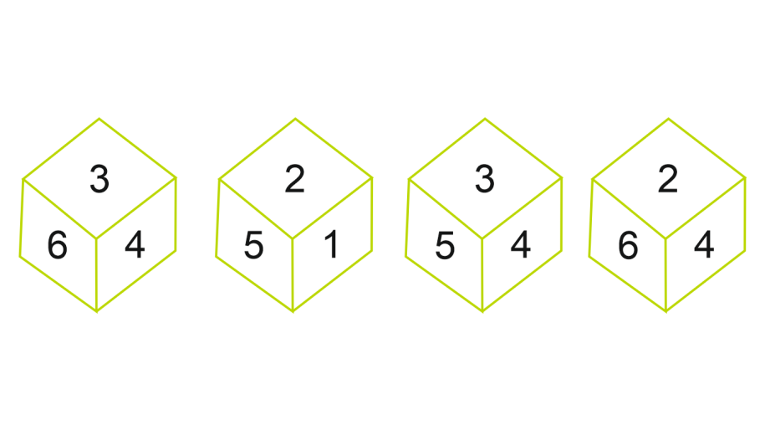
MORE PRACTICE PROBLEMS
Opposite to 3 ?
Opposite to 3 ?

Slide 21
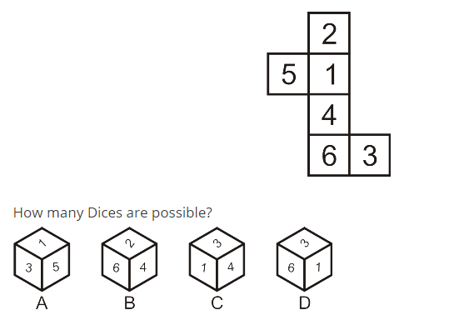
MORE PRACTICE PROBLEMS – OPEN DICES
Only A
Only C
A and B only
All in the options

Slide 22
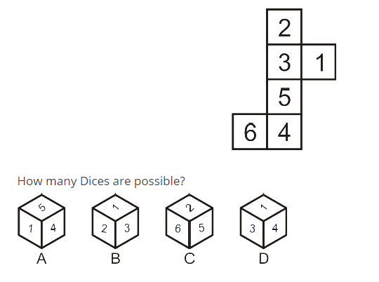
MORE PRACTICE PROBLEMS – OPEN DICES
Only C
Only B
A and B only
All in the options

Slide 23
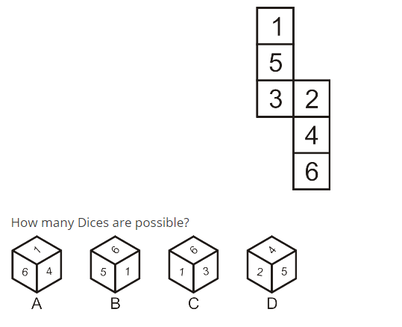
MORE PRACTICE PROBLEMS – OPEN DICES
Only C
Only D
A and B only
All in the options

Slide 24
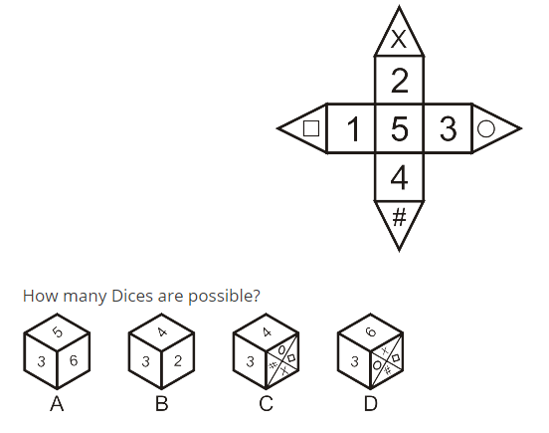
MORE PRACTICE PROBLEMS – OPEN DICES
Only A
Only B
Only D
None of the options

Slide 25
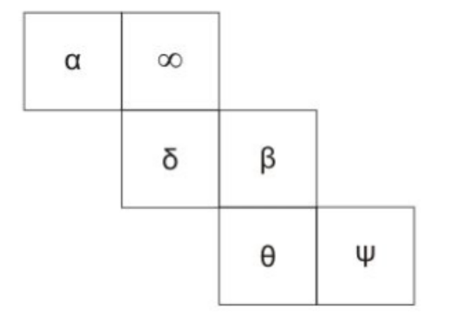
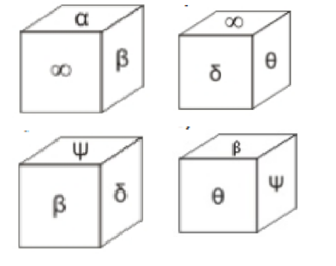
MORE PRACTICE PROBLEMS – OPEN DICES
B
A
D
C
Only A B. Only B C. Only C D. Only D

Slide 26
NUMBERED CUBES – HIGHER ORDER THINKING
A large cube, of total volume 125 cm³ is made up of smaller 1 cm³ cubes. The larger cube is made by following these rules
1. Start from the left hand side, and number the small cubes
1 to 5, from left to right. 2. Place cube no. 6 behind cube no. 1 to start the second
row, and proceed all the way to cube no. 25 3. Start the second layer on top of cube no 1, and build the
second layer from left to right, and front to back like the
first layer.
.

Slide 27
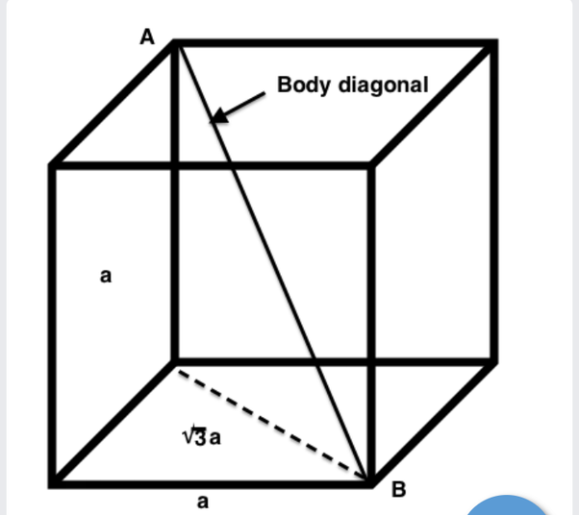
21 | 22 | 23 | 24 | 25
16 | 17 | 18 | 19 | 20
11 | 12 | 13 | 14 | 15
6 | 7 | 8 | 9 | 10
1 | 2 | 3 | 4 | 5

Slide 28

Question 1:
On the bottom-most square layer of the cube,
consider the surface diagonal that has the
square numbered 5, find the sum of all the
numbers on the cubes on this surface diagonal
on the bottom-most layer.

Slide 29
Question 2:
Find the number on the small cube at the other
end of the body diagonal that has the small
cube numbered 1.

Slide 30

Question 3:
Find the number on the small cube at the other
end of the body diagonal that has the small cube
numbered 21.

Slide 31
Question 4:
Find the sum of all the numbers on the body
diagonal that has the small cube numbered 1.

Slide 32

Question 5:
On the big cube, there exists an external surface
whose four corner cubes have the numbers 5, 25,
105 & 125. Find the sum of all the numbers on
the cubes on this surface.

Slide 33
PRACTICE QUESTIONS

Slide 34
JUST FOR FUN
E
A cube has 6 sides, each of which is
inscribed with a different object: ring,
gun, boost, rope, bread and dove.
The ring is opposite to the boost. The
gun is in between ring and boost.
The rope is adjacent to the dove and
the bread is adjacent to the rope. The
ring faces down. The side opposite to
bread is ?
A
S
Y

Slide 35
What is the minimum number of cuts made on a larger cube
to get 60 smaller cuboids of equal sizes?
A solid cube of side 12 cm has been painted red on all six
faces. It is then cut into cubical blocks of side 3 cm each.
How many cubes will have only one face painted ?
How many smaller cubes of side 1cm are there in a hollow
cube of side 5 cm and thickness 1cm?

Slide 36
Consider a hollow cube of side 4cm, with the thickness
of 1cm. It is made up of smaller cubes of size 1 cm. If
the outer surface of the cube is painted green, then how
many faces of the smaller cubes remain unpainted?
A solid cubical block composed of 6 6 6 smaller cubes is
made hollow by removing the inner core. If this inner
core made hollow by removing its inner core in turn,
then how many smaller cubes are remaining in the first
inner core?

Slide 37
A large cube, of total volume 216 cm³ is made up of smaller 1 cm³ cubes. The larger cube is made by following these rules
1. Start from the left hand side, and number the small cubes
1 to 6, from left to right. 2. Place cube no. 7 behind cube no. 1 to start the second
row, and proceed all the way to cube no. 36 3. Start the second layer on top of cube no 1, and build the
second layer from left to right, and front to back like the
first layer.

Slide 38

A large cube, of total volume 1331 cm³ is made up of smaller 1 cm³ cubes.
The larger cube is made by following these rules
1. Start from the left hand side, and number the small cubes 1 to 11, from left
to right. 2. Place cube no. 12 behind cube no. 1 to start the second row,
and proceed all the way to cube no. 121 3. Start the second layer on top of cube no 1, and build the
second layer from left to right, and front to back like the first layer.
What will be the sum of the numbers / number on the
cube, through which the body diagonals from cube
numbered 1 and cube numbered 111 cross each other.
HIGHER ORDER THINKING – THINK AND ANSWER

Slide 39
Question 1:
On the bottom-most square layer of the cube, consider the
surface diagonal that has the square numbered 6, find the sum
of all the numbers on the cubes on this surface diagonal on the
bottom-most layer.
Question 2:
Find the number on the small cube at the other end of the body
diagonal that has the small cube numbered 1.
Question 3:
Find the number on the small cube at the other end of the body
diagonal that has the small cube numbered 31.

Slide 40
Question 4:
Find the sum of all the numbers on the body diagonal that
has the small cube numbered 1.
Question 5:
On the big cube, there exists an external surface whose four
corner cubes have the numbers 6, 36, 186 and 216. Find the
sum of all the numbers on the cubes on this surface.

Slide 41
CALENDARS
1 LEAP YEAR –
1 ORDINARY YEAR –
100 YEARS –
200 YEARS –
300 YEARS –
400 YEARS -

Slide 46
THANK YOU

